Slide 1



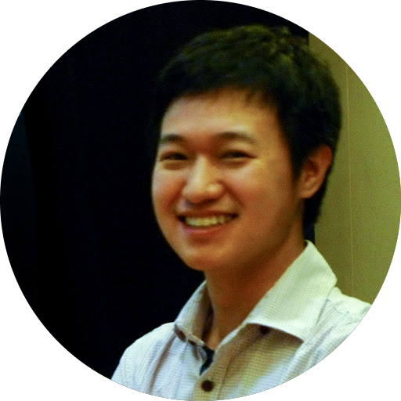
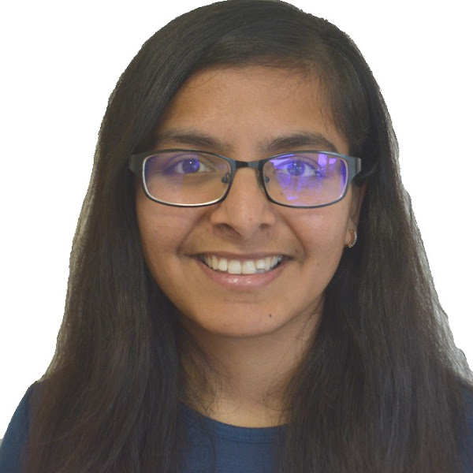
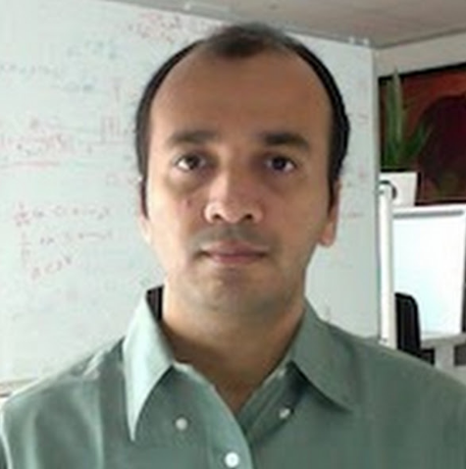



Speculative cascades: faster cascades via speculative decoding
Hari Narasimhan
Wittawat Jitkrittum
Ankit Singh Rawat
Seungyeon Kim†
Neha Gupta‡
Aditya Menon
Sanjiv Kumar
† Now at Meta ‡ Now at Mistral

Slide 2


Tradeoffs in LM scaling
Scaling LMs generally imposes inference cost versus quality tradeoffs
Quality
(e.g., accuracy)
🤩
Large LM p_{L}
Can leverage both models to reduce large LM cost!
Small LM p_{S}
Cost (e.g., latency)
Icons from emojis.com

Slide 3
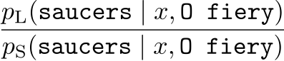
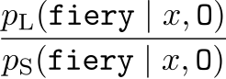
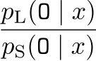
Speculative decoding
Draft with small model; verify with large model
…
…
O fiery saucers flying
Large model
Small model
x = “Write a poem about aliens in the style of Shakespeare”
… Shakespeare
O
fiery
saucers
flying
(1) Generate tokens from small model
(2) Score tokens’ relative likelihood in parallel
Leviathan et al. Fast Inference from Transformers via Speculative Decoding. ICML 2023.
Chen et al. Accelerating large language model decoding with speculative sampling. arXiV 2023.
Notes:
\frac{p_{\rm L}( \texttt{O} \mid x )}{p_{\rm S}( \texttt{O} \mid x )}
\frac{p_{\rm L}( \texttt{fiery} \mid x, \texttt{O} )}{p_{\rm S}( \texttt{fiery} \mid x, \texttt{O} )}

Slide 4
Speculative decoding
Draft with small model; verify with large model
✅
✅
✅
chariots
✅
❌
✅
✅
O fiery saucers flying
flying in skies above
Large model
Large model
Small model
x = “Write a poem about aliens in the style of Shakespeare”
x = “Write a poem about aliens in the style of Shakespeare” O fiery chariots
… Shakespeare
… Shakespeare
O
O
fiery
fiery
saucers
saucers
flying
flying
(5) Continue small model generation
(4) Resample first rejected token
(3) Stochastically accept tokens
Notes:
\frac{p_{\rm L}( \texttt{O} \mid x )}{p_{\rm S}( \texttt{O} \mid x )}
\frac{p_{\rm L}( \texttt{fiery} \mid x, \texttt{O} )}{p_{\rm S}( \texttt{fiery} \mid x, \texttt{O} )}

Slide 5
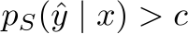
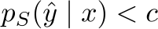
Cascades
Try to use small model; if uncertain, defer to large model
Deem small model “uncertain” if, e.g., it assigns low probability to output
O fiery saucers…
= O fiery saucers…
Large model
Small model
Defer?
O wondrous skies…
x = “Write a poem about aliens in the style of Shakespeare”
Chen et al. FrugalGPT: How to use large language models while reducing cost and improving performance. TMLR 2024.
Gupta et al. Language model cascades: token-level uncertainty and beyond. ICLR 2024.
Notes:
p_{S}( \texttt{O fiery saucers} \ldots \mid x ) < c
p_{S}( \hat{y} \mid x ) > c

Slide 6
A tale of two inference strategies
Speculative Decoding
Cascades
Potentially outperform large model!
🤞
Matches large model quality at lower cost!
Quality
(e.g., accuracy)
Quality
(e.g., accuracy)
Varying % of large model calls
Cost (e.g., latency)
Cost (e.g., latency)
Kim et al. Speculative Decoding with Big Little Decoder. NeurIPS 2023.
Jitkrittum et al. When does confidence based cascade deferral suffice? NeurIPS 2023.

Slide 7
A tale of two inference strategies
Speculative Decoding
Cascades
Draft with small model, verify with large model
Try to use small model; if uncertain, use large model
Can we leverage the best of both approaches?
😎 Quality-preserving speedup
💡
Mimic large model distribution
😎 Quality-enhancing speedup (potentially 🤞)
💡
Mimic data-generating distribution

Slide 8
Speculative cascades: summary
Target = p_{L}
Target = 𝜋
Small model
Large model
Small model
Small model
Defer?
Large model
Drafter
(sequential)
Verifier
(parallel)
Drafter
(sequential)
Verifier
(parallel)
Guarantee
Probability of sampling v is p_{L}(v)
Guarantee
Probability of sampling v is 𝜋(v)
Speculative Decoding
Speculative Cascading
(our proposal)

Slide 9
Token-level cascades
Consider a token-level cascade
✅
“Write a poem about aliens in the style of Shakespeare”
O
Defer?
Large model
Small model
“Write a poem about aliens in the style of Shakespeare” O
saucers
❌
fiery
Defer?
Large model
Small model
How to design the deferral rule?

Slide 10
(Bayes-)Optimal cascade deferral
Given any sequence x_{<t} = x₁, …, x_{t-1}, we want a deferral rule r(x_{<t}) ∈ { 0, 1 }
r(x_{<t}) = 1 ⟺ invoke large model
What does the ideal rule look like?
Fact: The Bayes-optimal token deferral rule r* is
Data-generation distribution
Expected loss gap
Cost of invoking p_{Large}
Notes:
r^*( x_{< t} ) = 1 \iff \mathbb{E}_{v \sim \mathbb{P}( \cdot \mid x_{< t} )}[ \ell( v, p_{\rm Small}( \cdot \mid x_{<t} ) ) ] - \mathbb{E}_{v \sim \mathbb{P}( \cdot \mid x_{< t} )}[ \ell( v, p_{\rm Large}( \cdot \mid x_{<t} ) ) ] > \alpha
r^*( x_{< t} ) = 1 \iff \mathbb{E}_{v \sim \mathbb{P}( \cdot \mid x_{< t} )}[ \ell( v, p_{\rm Small} ) ] - \mathbb{E}_{v \sim \mathbb{P}( \cdot \mid x_{< t} )}[ \ell( v, p_{\rm Large} ) ] > c

Slide 11
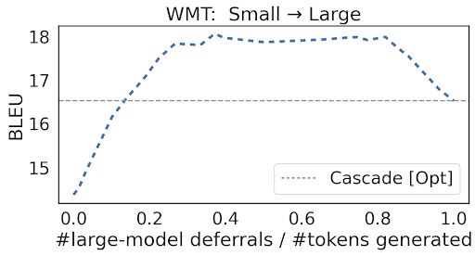
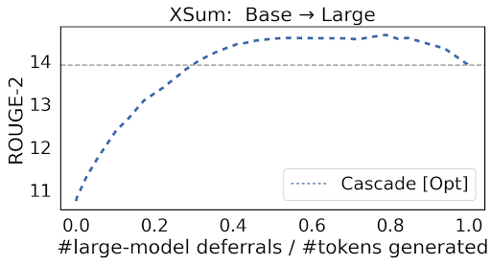
(Bayes-)Optimal cascade deferral
Given any context x_{<t} = x₁, …, x_{t-1}, we want a deferral rule r(x_{<t}) ∈ { 0, 1 }
r(x_{<t}) = 1 ⟺ invoke large model
How does the ideal rule perform?
Requires calling large model!
Large model’s
quality
Notes:
r^*( x_{< t} ) = 1 \iff \mathbb{E}_{v \sim \mathbb{P}( \cdot \mid x_{< t} )}[ \ell( v, p_{\rm Small}( \cdot \mid x_{<t} ) ) ] - \mathbb{E}_{v \sim \mathbb{P}( \cdot \mid x_{< t} )}[ \ell( v, p_{\rm Large}( \cdot \mid x_{<t} ) ) ] > \alpha
r^*( x_{< t} ) = 1 \iff \mathbb{E}_{v \sim \mathbb{P}( \cdot \mid x_{< t} )}[ \ell( v, p_{\rm Small} ) ] - \mathbb{E}_{v \sim \mathbb{P}( \cdot \mid x_{< t} )}[ \ell( v, p_{\rm Large} ) ] > c

Slide 12
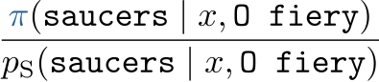
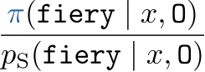
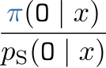
Speculative cascades
Speculative execution using alternate target distribution for verification!
Target distribution 𝜋 is defined by a deferral rule:
Target = p_{L}
Target = 𝜋
…
…
…
…
Large model
Large model
… Shakespeare
O
fiery
saucers
flying
… Shakespeare
O
fiery
saucers
flying
Speculative Decoding
Speculative Cascading
(our proposal)
Notes:
\frac{p_{\rm L}( \texttt{O} \mid x )}{p_{\rm S}( \texttt{O} \mid x )}
\frac{p_{\rm L}( \texttt{fiery} \mid x, \texttt{O} )}{p_{\rm S}( \texttt{fiery} \mid x, \texttt{O} )}

Slide 13
Speculative cascades: deferral rules
Speculative execution using alternate target distribution for verification!
Target distribution 𝜋 is defined by a deferral rule:
Fact: The Bayes-optimal token deferral rule r* is
Expected loss gap
Total probability gap
* The rule is Bayes-optimal for minimising the expected loss against the ground-truth token, subject to a bound on the rejection rate.
Notes:
\pi( \cdot ) = ( 1 - {\color{RoyalBlue}r( x_{<t} )} ) \cdot p_{\rm Small}( \cdot ) + {\color{RoyalBlue}r( x_{<t} )} \cdot p_{\rm Large}( \cdot )
r^*( x_{< t} ) = 1 \iff \mathbb{E}_{v \sim \mathbb{P}( \cdot \mid x_{< t} )}[ \ell( v, p_{\rm Small} ) ] - \mathbb{E}_{v \sim \mathbb{P}( \cdot \mid x_{< t} )}[ \ell( v, p_{\rm Large} ) ] > \alpha \cdot {\color{RoyalBlue}D_{\rm TV}( p_{\rm Large}, p_{\rm Small} )}
\hat{r}( x_{< t} ) = 1 \iff \max_{v \in \mathscr{V}} p_{\rm Large}( v \mid x_{< t} ) - \max_{v \in \mathscr{V}} p_{\rm Small}( v \mid x_{< t} ) > c \cdot {\color{RoyalBlue}D_{\rm TV}( p_{\rm Large}, p_{\rm Small} )}

Slide 14
Speculative cascades: deferral rules
Speculative execution using alternate target distribution for verification!
Target distribution 𝜋 is defined by a deferral rule:
An approximation to the Bayes-optimal rule r is
Confidence gap
Total probability gap
* The rule is Bayes-optimal for minimising the expected loss against the ground-truth token, subject to a bound on the rejection rate.
Notes:
\pi( \cdot ) = ( 1 - {\color{RoyalBlue}r( x_{<t} )} ) \cdot p_{\rm Small}( \cdot ) + {\color{RoyalBlue}r( x_{<t} )} \cdot p_{\rm Large}( \cdot )
r^*( x_{< t} ) = 1 \iff \mathbb{E}_{v \sim \mathbb{P}( \cdot \mid x_{< t} )}[ \ell( v, p_{\rm Small} ) ] - \mathbb{E}_{v \sim \mathbb{P}( \cdot \mid x_{< t} )}[ \ell( v, p_{\rm Large} ) ] > \alpha \cdot {\color{RoyalBlue}D_{\rm TV}( p_{\rm Large}, p_{\rm Small} )}
\hat{r}( x_{< t} ) = 1 \iff \max_{v \in \mathscr{V}} p_{\rm Large}( v \mid x_{< t} ) - \max_{v \in \mathscr{V}} p_{\rm Small}( v \mid x_{< t} ) > c \cdot {\color{RoyalBlue}D_{\rm TV}( p_{\rm Large}, p_{\rm Small} )}

Slide 15
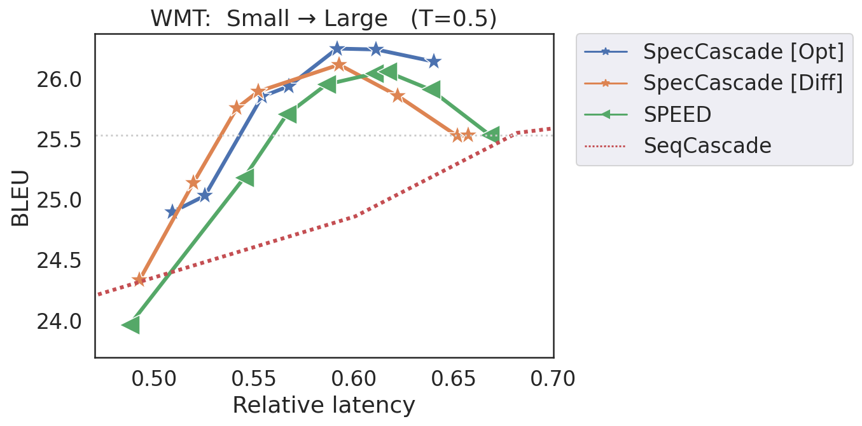
Empirical results: fine-tuned T5 models
Large model’s
quality
SpecCascade [OPT]
SpecCascade [Diff]
SpecDecode [Lossy]
TokenCascade
SpecCascades offer the best trade-offs
Compared to speculative decoding, 1.61x → 1.95x speed-up

Slide 16
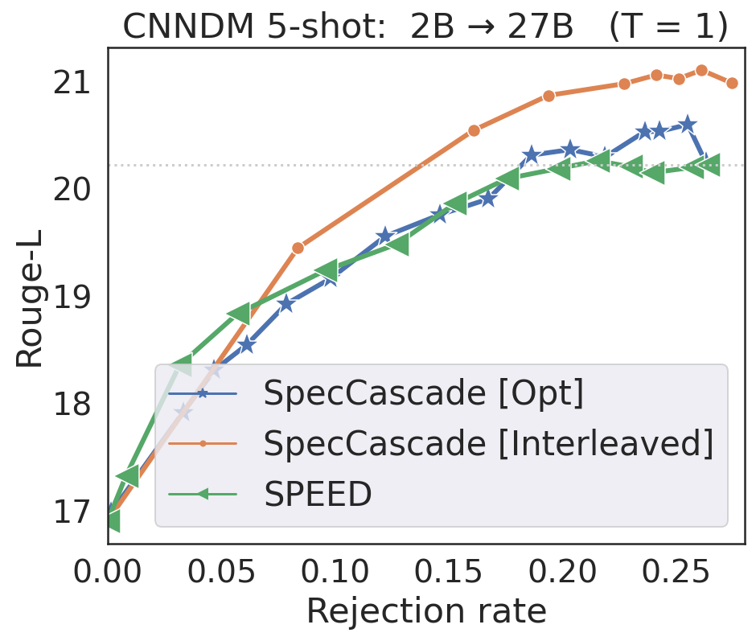
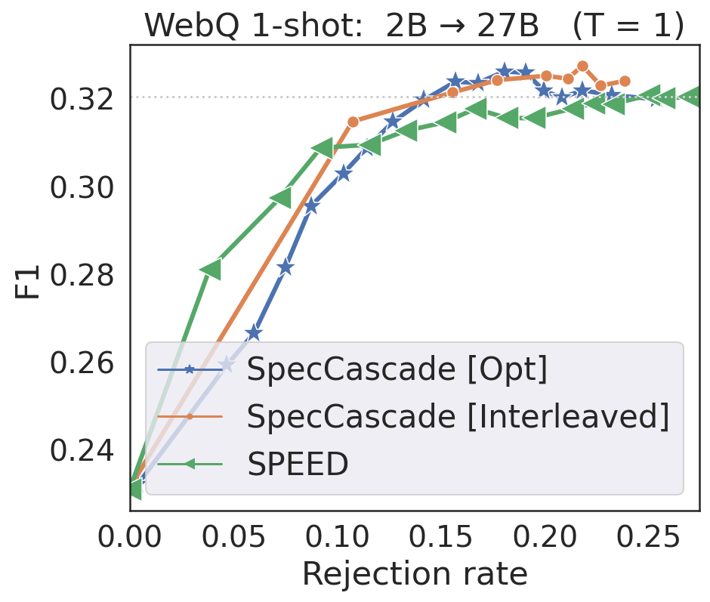
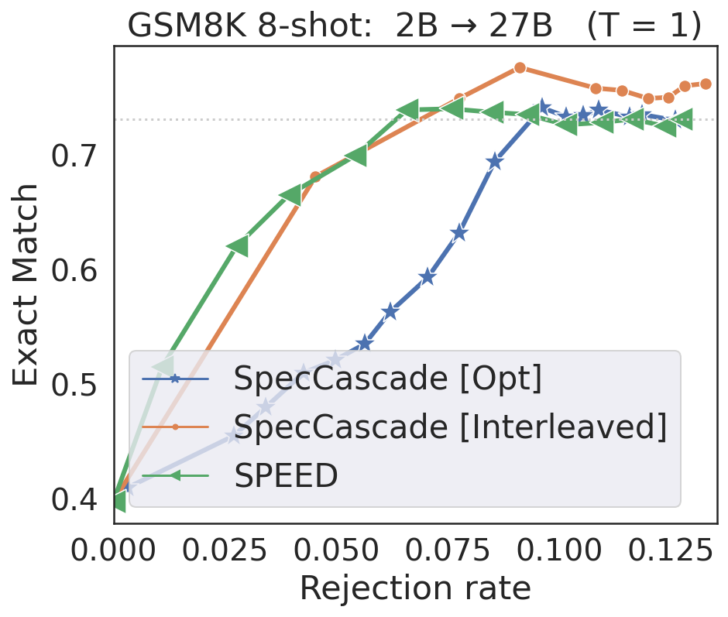
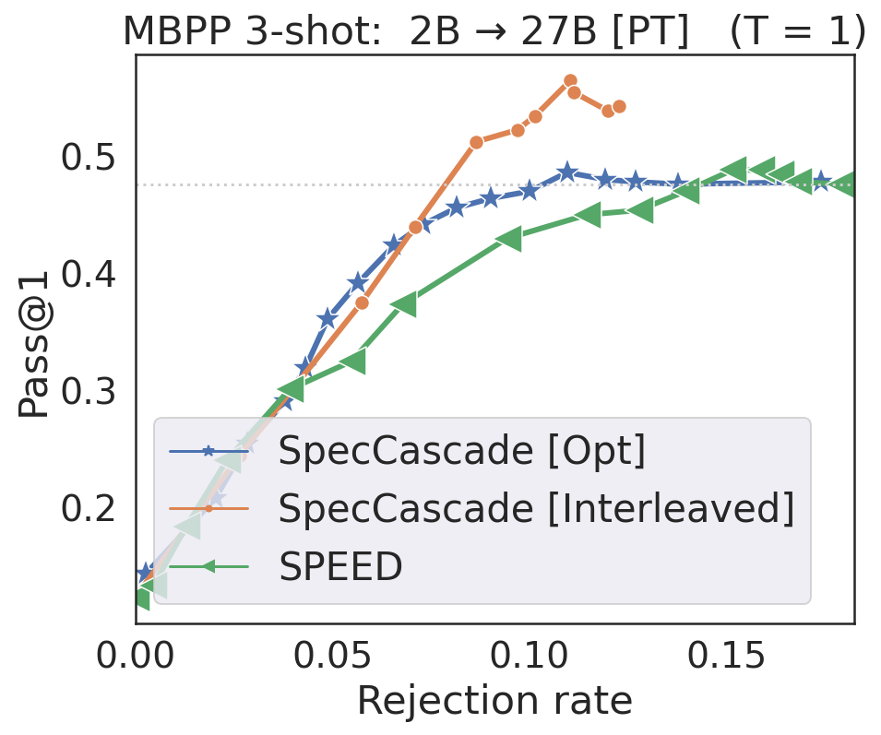
Empirical results: few-shot Gemma models
Can exceed large model’s quality!

Slide 17
Summary
Speculative execution with a modified target distribution 𝜋
Mimic data-generation versus large model distribution
Define 𝜋 via a deferral rule
Potentially exceed large model performance!
More details in the paper!
Relation to approximate verification techniques
Token-specific deferral
Target = 𝜋
Small model
Small model
Defer?
Large model
Drafter
(sequential)
Verifier
(parallel)
Guarantee
Probability of sampling v is 𝜋(v)

Slide 18
Acknowledgements
Emojis from emojis.com
AI Large
AI Small

Slide 19
Appendix

Slide 20
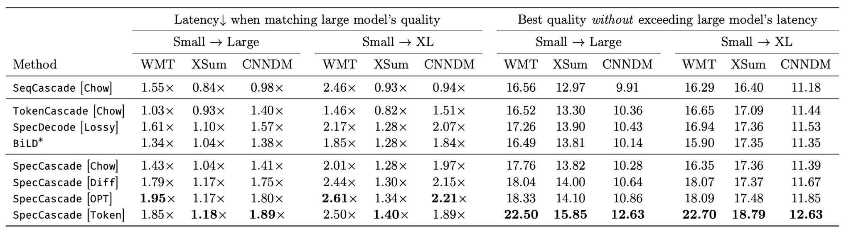
Empirical results: fine-tuned T5 models
Better tradeoffs → gains in latency or quality

Slide 21
Speculative decoding
Draft with small model; verify with large model
chariots
✅
✅
✅
✅
❌
✅
✅
O fiery saucers flying
Large model
Large model
Small model
“Write a poem about aliens in the style of Shakespeare”
… Shakespeare
O
fiery
saucers
flying
Leviathan et al. Fast Inference from Transformers via Speculative Decoding. ICML 2023.
Chen et al. Accelerating large language model decoding with speculative sampling. arXiV 2023.
Notes:
\frac{p_{\rm L}( \texttt{O} \mid x )}{p_{\rm S}( \texttt{O} \mid x )}
\frac{p_{\rm L}( \texttt{fiery} \mid x, \texttt{O} )}{p_{\rm S}( \texttt{fiery} \mid x, \texttt{O} )}

Slide 22
Cascades: cost-quality tradeoff
Try to use small model; if uncertain, use large model
Quality
(e.g., accuracy)
Potentially do better than large model!
Varying % of large model calls
Cost (e.g., latency)

Slide 23
Speculative decoding: cost-quality tradeoff
Draft with small model; (stochastically) verify with large model
Quality
(e.g., accuracy)
Guaranteed quality preservation!
Cost (e.g., latency)

Slide 24
Cascades versus speculative decoding
Cascades
Speculative Decoding
😎 Quality-enhancing speedup (sometimes 🤞)
💡Mimic data-generating distribution
😎 Quality-preserving speedup
💡Mimic verifier distribution
Can we combine both approaches?
Quality
(e.g., accuracy)
Quality
(e.g., accuracy)
Cost (e.g., latency)
Cost (e.g., latency)

Slide 25
Post-hoc deferral
Let h⁽¹⁾, h⁽²⁾ denote the small & large model
For x ∈ X, let r(x) ∈ { 0, 1 } denote whether or not to invoke h⁽²⁾
Goal: learn r(x) achieving
minimal average loss ℓ of chosen model
with a penalty for every large model invocation
r decides to call h⁽¹⁾
r decides to call h⁽²⁾
rate of calling h⁽²⁾
Loss of small model
Loss of large model
Notes:
\min_{r \colon \mathscr{X} \to \{ 0, 1 \}} \mathbb{E}_{(x,y)}\left[ 1( r( x ) = 0 ) \cdot \ell( y, h^{(1)}( x ) ) + 1( r( x ) = 1 ) \cdot \ell( y, h^{(2)}( x ) ) \right] + c \cdot \mathbb{P}_{x}( r( x ) = 1 )
\min_{r} \mathbb{E}_{(x,y)}\left[ 1( r( x ) = 0 ) \cdot \ell( y, h^{(1)}( x ) ) + 1( r( x ) = 1 ) \cdot \ell( y, h^{(2)}( x ) ) \right]
\text{ subject to } \mathbb{P}_{x}( r( x ) = 1 ) \leq \tau

Slide 26
(Bayes-)Optimal token deferral
Suppose we have a context x_{<t} = x₁, …, x_{t-1}
The Bayes-optimal token deferral takes the form:
We cannot realise this rule – requires calling p_{Large}!
🤔 Unless we mimic speculative decoding…
Fact: The Bayes-optimal token deferral rule r* is
Expected loss gap
Cost of invoking p_{Large}
Notes:
r^*( x_{< t} ) = 1 \iff \mathbb{E}_{v \sim \mathbb{P}( \cdot \mid x_{< t} )}[ \ell( v, p_{\rm Small}( \cdot \mid x_{<t} ) ) ] - \mathbb{E}_{v \sim \mathbb{P}( \cdot \mid x_{< t} )}[ \ell( v, p_{\rm Large}( \cdot \mid x_{<t} ) ) ] > \alpha

Slide 27
How to allow adaptive compute paths?
Key idea: use larger models sparingly, only for few (“hard”) cases
Speculative decoding
“Write a poem about aliens in the style of Shakespeare”
O fiery saucers flying…
Verify
Large model
Small model
O fiery chariots flying…
Leviathan et al. Fast inference from Transformers via speculative decoding. ICML 2023.

Slide 28
Bayes-optimal deferral: approximation
In practice, we cannot compute expectations under ℙ
Depending on the choice of loss ℓ, we can construct plug-in estimators:
Under temperature sampling, we may further condition on drafted tokens; e.g.,
Notes:
r^*( x_{< t} ) = 1 \iff \mathbb{E}_{v \sim \mathbb{P}( \cdot \mid x_{< t} )}[ \ell( v, p_{\rm Small} ) ] - \mathbb{E}_{v \sim \mathbb{P}( \cdot \mid x_{< t} )}[ \ell( v, p_{\rm Large} ) ] > \alpha \cdot {\color{RoyalBlue}D_{\rm TV}( p_{\rm Large}, p_{\rm Small} )}
r^*( x_{< t} ) = 1 \iff \max_{v \in \mathscr{V}} p_{\rm Large}( v \mid x_{< t} ) - \max_{v \in \mathscr{V}} p_{\rm Small}( v \mid x_{< t} ) > \alpha \cdot {\color{RoyalBlue}D_{\rm TV}( p_{\rm Large}, p_{\rm Small} )}
r^*( x_{< t} ) = 1 \iff H( p_{\rm Small}( \cdot \mid x_{<t} ) ) - H( p_{\rm Large}( \cdot \mid x_{<t} ) ) > \alpha \cdot {\color{RoyalBlue}D_{\rm TV}( p_{\rm Large}, p_{\rm Small} )}
r^*( x_{< t}, {\color{RoyalBlue}v_{\rm Samp}} ) = 1 \iff \max_{v \in \mathscr{V}} p_{\rm Large}( v \mid x_{< t} ) - p_{\rm Small}( {\color{RoyalBlue}v_{\rm Samp}} \mid x_{< t} ) > \alpha

Slide 29
(Bayes-)Optimal cascade deferral
Given any context x_{<t} = x₁, …, x_{t-1}, we want a deferral rule r(x_{<t}) ∈ { 0, 1 }
r(x_{<t}) = 1 ⟺ invoke large model
A simple choice:
Can we do better?
Small model confidence
Cost of invoking p_{Large}
Fact: The Bayes-optimal token deferral rule r* is
Data-generation distribution
Expected loss gap
Cost of invoking p_{Large}
Notes:
r^*( x_{< t} ) = 1 \iff \mathbb{E}_{v \sim \mathbb{P}( \cdot \mid x_{< t} )}[ \ell( v, p_{\rm Small}( \cdot \mid x_{<t} ) ) ] - \mathbb{E}_{v \sim \mathbb{P}( \cdot \mid x_{< t} )}[ \ell( v, p_{\rm Large}( \cdot \mid x_{<t} ) ) ] > \alpha
r^*( x_{< t} ) = 1 \iff \mathbb{E}_{v \sim \mathbb{P}( \cdot \mid x_{< t} )}[ \ell( v, p_{\rm Small} ) ] - \mathbb{E}_{v \sim \mathbb{P}( \cdot \mid x_{< t} )}[ \ell( v, p_{\rm Large} ) ] > c

Slide 30
From speculative decoding to speculative cascades
Speculative execution using alternate target distribution for verification!
Target distribution 𝜋 is defined by a deferral rule:
Enhance cascading by leveraging information from both models!
Target = p_{L}
Target = 𝜋
…
…
…
…
Large model
Large model
… Shakespeare
O
fiery
saucers
flying
… Shakespeare
O
fiery
saucers
flying
Speculative Decoding
Speculative Cascading
(our proposal)
Notes:
\frac{p_{\rm L}( \texttt{O} \mid x )}{p_{\rm S}( \texttt{O} \mid x )}
\frac{p_{\rm L}( \texttt{fiery} \mid x, \texttt{O} )}{p_{\rm S}( \texttt{fiery} \mid x, \texttt{O} )}

Slide 31
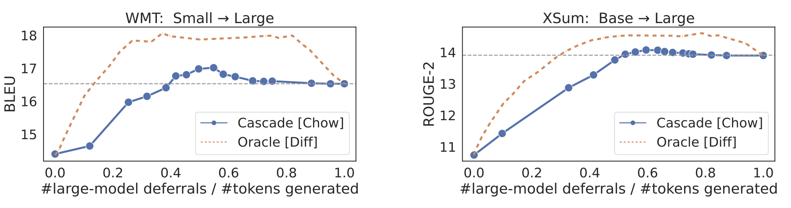
(Bayes-)Optimal cascade deferral
Optimal cascade deferral can outperform large model!
Realising this rule requires calling large model!
Confidence Optimal
Confidence Optimal

Slide 32
Verification via deferral rules
We choose the target distribution 𝜋 based on a deferral rule r:
Realising this rule requires calling the large model (as before)
Can mimic this rule in the speculative execution setup!
Fact: The Bayes-optimal token deferral rule r* is
Expected loss gap
Total probability gap
* The rule is Bayes-optimal for minimising the expected loss against the ground-truth token, subject to a bound on the rejection rate.
Notes:
\pi( \cdot ) = ( 1 - {\color{RoyalBlue}r( x_{<t} )} ) \cdot p_{\rm Small}( \cdot ) + {\color{RoyalBlue}r( x_{<t} )} \cdot p_{\rm Large}( \cdot )
r^*( x_{< t} ) = 1 \iff \mathbb{E}_{v \sim \mathbb{P}( \cdot \mid x_{< t} )}[ \ell( v, p_{\rm Small} ) ] - \mathbb{E}_{v \sim \mathbb{P}( \cdot \mid x_{< t} )}[ \ell( v, p_{\rm Large} ) ] > \alpha \cdot {\color{RoyalBlue}D_{\rm TV}( p_{\rm Large}, p_{\rm Small} )}
\hat{r}( x_{< t} ) = 1 \iff \max_{v \in \mathscr{V}} p_{\rm Large}( v \mid x_{< t} ) - \max_{v \in \mathscr{V}} p_{\rm Small}( v \mid x_{< t} ) > c \cdot {\color{RoyalBlue}D_{\rm TV}( p_{\rm Large}, p_{\rm Small} )}

Slide 33
Approximating optimal deferral
Fact: The Bayes-optimal token deferral rule r* is
In practice, we cannot compute expectations under ℙ!
Depending on the choice of loss ℓ, we can construct plug-in estimators:
Confidence gap
Total probability gap
Notes:
r^*( x_{< t} ) = 1 \iff \mathbb{E}_{v \sim \mathbb{P}( \cdot \mid x_{< t} )}[ \ell( v, p_{\rm Small} ) ] - \mathbb{E}_{v \sim \mathbb{P}( \cdot \mid x_{< t} )}[ \ell( v, p_{\rm Large} ) ] > \alpha \cdot {\color{RoyalBlue}D_{\rm TV}( p_{\rm Large}, p_{\rm Small} )}
r^*( x_{< t} ) = 1 \iff \max_{v \in \mathscr{V}} p_{\rm Large}( v \mid x_{< t} ) - \max_{v \in \mathscr{V}} p_{\rm Small}( v \mid x_{< t} ) > \alpha \cdot {\color{RoyalBlue}D_{\rm TV}( p_{\rm Large}, p_{\rm Small} )}
r^*( x_{< t} ) = 1 \iff H( p_{\rm Small}( \cdot \mid x_{<t} ) ) - H( p_{\rm Large}( \cdot \mid x_{<t} ) ) > \alpha \cdot {\color{RoyalBlue}D_{\rm TV}( p_{\rm Large}, p_{\rm Small} )}
r^*( x_{< t}, {\color{RoyalBlue}v_{\rm Samp}} ) = 1 \iff \max_{v \in \mathscr{V}} p_{\rm Large}( v \mid x_{< t} ) - p_{\rm Small}( {\color{RoyalBlue}v_{\rm Samp}} \mid x_{< t} ) > \alpha

Slide 34
Verification via deferral rules
Speculative execution using alternate target distribution for verification!
Target distribution 𝜋 is defined by a deferral rule:
Can construct empirical approximations:
Fact: The Bayes-optimal token deferral rule r* is
Expected loss gap
Total probability gap
Confidence gap
Total probability gap
* The rule is Bayes-optimal for minimising the expected loss against the ground-truth token, subject to a bound on the rejection rate.
Notes:
\pi( \cdot ) = ( 1 - {\color{RoyalBlue}r( x_{<t} )} ) \cdot p_{\rm Small}( \cdot ) + {\color{RoyalBlue}r( x_{<t} )} \cdot p_{\rm Large}( \cdot )
r^*( x_{< t} ) = 1 \iff \mathbb{E}_{v \sim \mathbb{P}( \cdot \mid x_{< t} )}[ \ell( v, p_{\rm Small} ) ] - \mathbb{E}_{v \sim \mathbb{P}( \cdot \mid x_{< t} )}[ \ell( v, p_{\rm Large} ) ] > \alpha \cdot {\color{RoyalBlue}D_{\rm TV}( p_{\rm Large}, p_{\rm Small} )}
\hat{r}( x_{< t} ) = 1 \iff \max_{v \in \mathscr{V}} p_{\rm Large}( v \mid x_{< t} ) - \max_{v \in \mathscr{V}} p_{\rm Small}( v \mid x_{< t} ) > c \cdot {\color{RoyalBlue}D_{\rm TV}( p_{\rm Large}, p_{\rm Small} )}

Slide 35
(Bayes-)Optimal cascade deferral
Given any context x_{<t} = x₁, …, x_{t-1}, we want a deferral rule r(x_{<t}) ∈ { 0, 1 }
r(x_{<t}) = 1 ⟺ invoke large model
How does the optimal rule perform?
Requires calling large model!
Notes:
r^*( x_{< t} ) = 1 \iff \mathbb{E}_{v \sim \mathbb{P}( \cdot \mid x_{< t} )}[ \ell( v, p_{\rm Small}( \cdot \mid x_{<t} ) ) ] - \mathbb{E}_{v \sim \mathbb{P}( \cdot \mid x_{< t} )}[ \ell( v, p_{\rm Large}( \cdot \mid x_{<t} ) ) ] > \alpha
r^*( x_{< t} ) = 1 \iff \mathbb{E}_{v \sim \mathbb{P}( \cdot \mid x_{< t} )}[ \ell( v, p_{\rm Small} ) ] - \mathbb{E}_{v \sim \mathbb{P}( \cdot \mid x_{< t} )}[ \ell( v, p_{\rm Large} ) ] > c

Slide 36
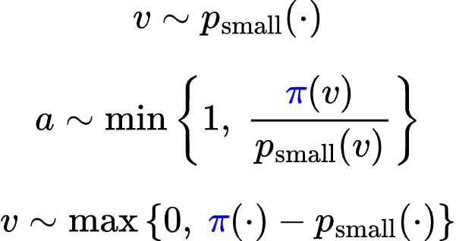
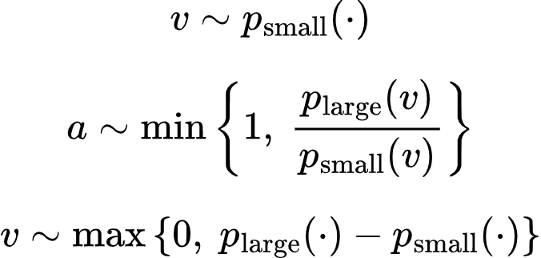
Speculative cascades: summary
Sample from small model:
Should we accept the sampled token?
If a = 1, return v. Else, re-sample from:
Sample from small model:
Should we accept the sampled token?
If a = 1, return v. Else, re-sample from:
Guarantee
Probability of sampling v is
Guarantee
Probability of sampling v is
There are lossy variants that allow deviations from p_{large} (Leviathan et al. ‘23, Tran-Thien ‘23)
We allow 𝜋 to depend on p_{Large}, p_{Small}
Speculative Decoding
Speculative Cascading

